Slide 1


The Power of Invisibility: Factors that Influence Attendance
ATTENDANCE SUPPORT SESSION 1
Notes:
Source: What Motivates Students to Turn Around Attendance? (Eskolta School Research and Design)

Slide 2
“It’s easier to stay and do work because I know I have people behind me.”
—A transfer school student reflecting on support from teachers

Slide 3
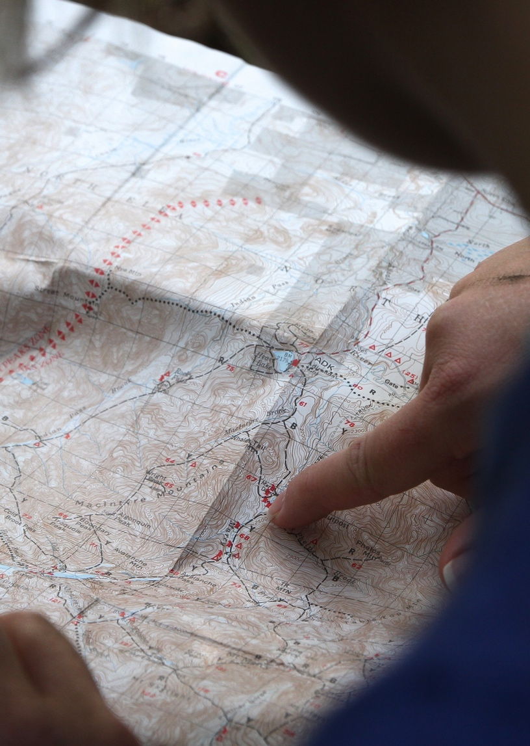
Objectives:
Understand how students’ relationships, beliefs about themselves as learners, and recognition of future prospects contribute to their attendance
Explore practices that help students feel connected, engaged, and optimistic in order to improve attendance
3

Slide 4

Review: What makes a student feel invisible?
Turn invisible and no one will care
I’m behind in work and I’m not sure if I can catch up.
People seem to think my issues are invisible
I have a late-night job and sometimes oversleep.
Why would I show up just to be reprimanded?
It seems like teachers only notice me when I’m doing something wrong.
Even though I don’t cause trouble, I get all of the blame when things go wrong.
No one—not even the teachers—seems to really see me
4

Slide 5
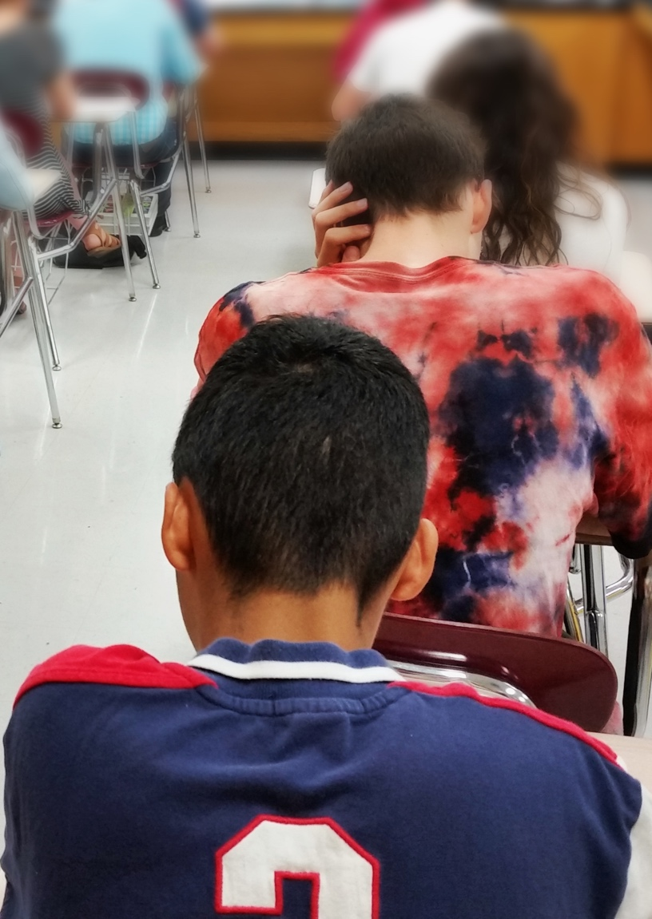
Reflect on Experiences:
Think of a student who appears to have the power of invisibility.
What does that look and feel like?
5

Slide 6
Nine Practices that Help Students Feel Visible
Greeting at the door every day
Morning check-in call or conversation
Daily personal connection
Home outreach (with positive parent-student relationship)
Conversation about effects on graduation
Meaningful feedback
Future-oriented discussions
Peer or extracurricular connections outside of class
Noticing patterns together
6

Slide 7
Practices that Motivate by Showing You Care
Greeting at the door every day
Morning check-in call or conversation
Daily personal connection
Home outreach (with positive parent-student relationship)
Conversation about effects on graduation
Meaningful feedback
Future-oriented discussions
Peer or extracurricular connections outside of class
Noticing patterns together
7

Slide 8
Practices that Motivate by Leveraging Others
Greeting at the door every day
Morning check-in call or conversation
Daily personal connection
Home outreach (with positive parent-student relationship)
Conversation about effects on graduation
Meaningful feedback
Future-oriented discussions
Peer or extracurricular connections outside of class
Noticing patterns together
8

Slide 9
Practices that Motivate by Showing Impact
Greeting at the door every day
Morning check-in call or conversation
Daily personal connection
Home outreach (with positive parent-student relationship)
Conversation about effects on graduation
Meaningful feedback
Future-oriented discussions
Peer or extracurricular connections outside of class
Noticing patterns together
9

Slide 10
Explore Practices:
Look over these nine practices to improve attendance:
Make note of any elements that connect to what students at your school might experience.
Greeting at the door every day
Morning check-in call or conversation
Home outreach (with positive parent-student relationship)
Daily personal connection
Conversation about effects on graduation
Meaningful feedback
Noticing patterns together
Future-oriented discussions
Peer or extracurricular connections outside of class
10

Slide 11
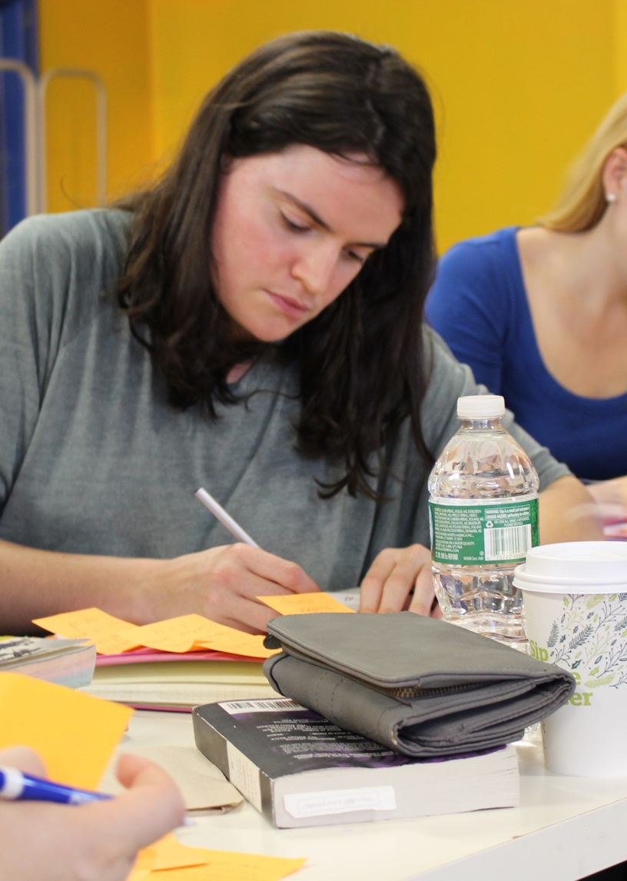
Deepen Understanding:
Select one piece of research to explore further in a small group.
Use the 4A’s Questions on your Note Catcher to reflect and discuss:
What is one takeaway you agree with?
What is one assumption the author makes?
What is one strategy you would argue with?
What is one thing from the research you aspire to do?
11

Slide 12

Set Goals:
Use the Planning Chart on your Note Catcher to reflect.
What is one big change that you and others at the school could make happen next year to improve attendance?
What is one medium-size goal that you can work with colleagues to make progress on during this year?
What is one small step you can individually take this week to improve attendance?
12

Slide 13

Share:
What are your big goals and small steps for supporting your students to improve their attendance?
Where do our ideas overlap?
How can we focus on the areas that are shared across multiple sets of ideas?
13

Slide 14
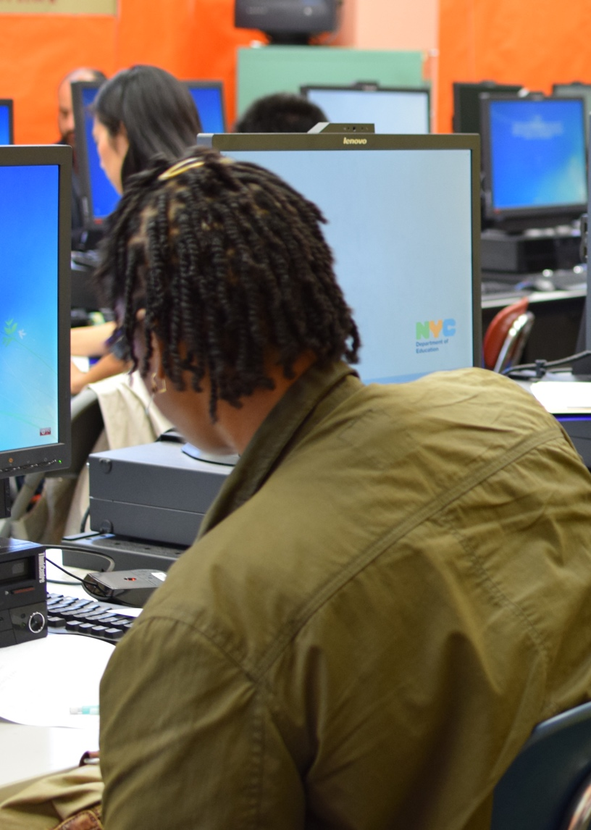
Learning Wrap-Up
Reflect on what you learned today.
How do your takeaways compare to the session’s Learning Objectives? How were these objectives addressed today?
LEARNING OBJECTIVES:
Understand how students’ relationships, beliefs about themselves as learners, and recognition of future prospects contribute to their attendance.
Explore practices that help students feel connected, engaged, and optimistic in order to improve attendance.
14

Slide 15

What’s next?
Learn more about the factors that contribute to irregular student attendance
Use current attendance data to identify students with irregular attendance and explore the root causes of their disengagement
Plan individual contributions to a school-wide system for promoting student attendance
Develop a resource to support attendance outreach to individual students as a counselor or teacher
15

